Slide 1
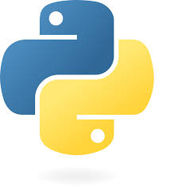
Introduction of Python
Dr. Ravirajsinh S. Vaghela

Slide 2
Introduction to Python
What is python?
WHY to use python?
Where to use python?

Slide 3
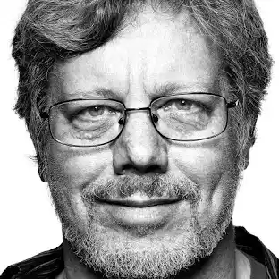
Introduction to Python
Python is a popular programming language.
It was created by Guido van Rossum , and released in 1991 at CWI (Centrum Wiskunde & Informatica) Netherland.
Python is General Purpose,High Level programming language,
Python is a dynamic programming.

Slide 4
FAQ
1. Who created Python?
Python created by Guido Van Rossum, a Dutch Programmer.
2. Why Python is called Python?
Python does not have any relation to Snake. The name of the Python programming language was inspired by a British Comedy Group Monty Python.
3. When was Python's first version released?
Python's first version was released in February 1991.
4. What was the first version of Python?
Python's first version was Python 0.9.0
5. When was Python 3.0 version released?
Python 3.0 version was released in December 2008.

Slide 5
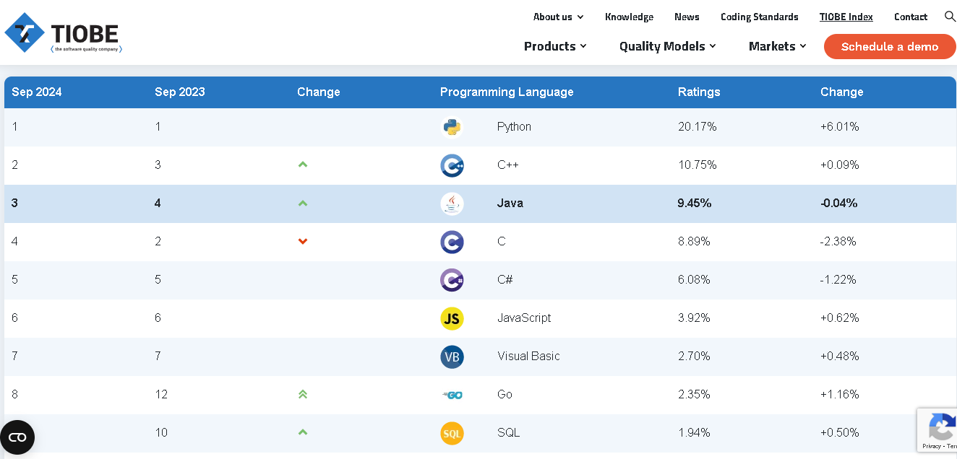
https://www.tiobe.com/tiobe-index/

Slide 6
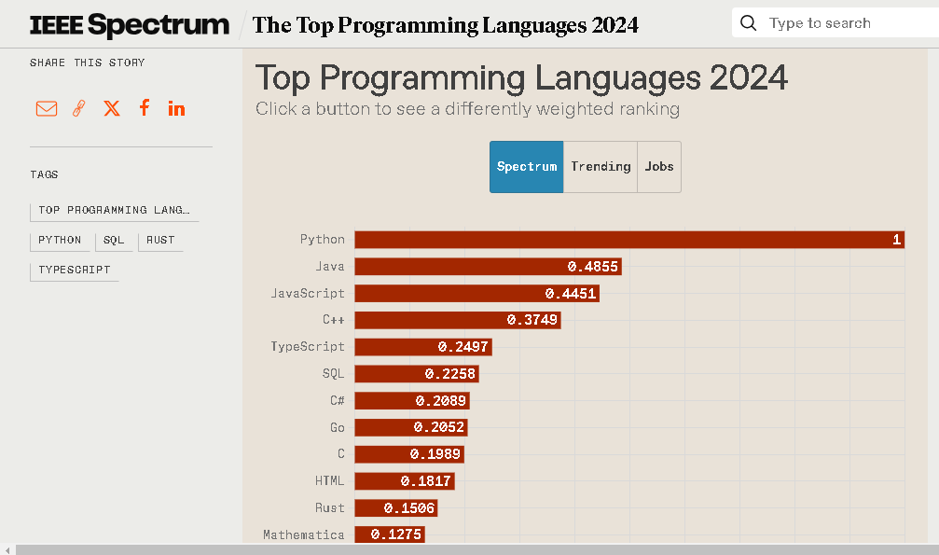
https://spectrum.ieee.org/top-programming-languages-2024

Slide 7
Why Python ? - Context of Programmer
Simple & Easy to Learn
Platform Independent
Free & Open Source
Interpreted (bytecode-compiled)
Rich Library support
Embeddable & Extensible
Portable
Robust

Slide 8
Where Python is Used?
Web frameworks and applications
GUI - based desktop applications
Graphic design , image processing applications, Games, and Scientific/ Computational Applications
ML/AI, Neural networks
Data Science, Data Visualization
IOT
Database Development
Installing Python
Checking Python installation & version
Setting the PATH variable (so python works from anywhere)
Creating & using a virtual environment

Slide 9
Python
C
Java
print(“Hello world”)
#include<stdio.h>
Int main()
{
printf(Hello world\n“)
return 0;
}
public class HelloWorld{
Public static void main(String[] args)
System.out. println(“Hello world”);
}
https://www.python.org/downloads/

Slide 10
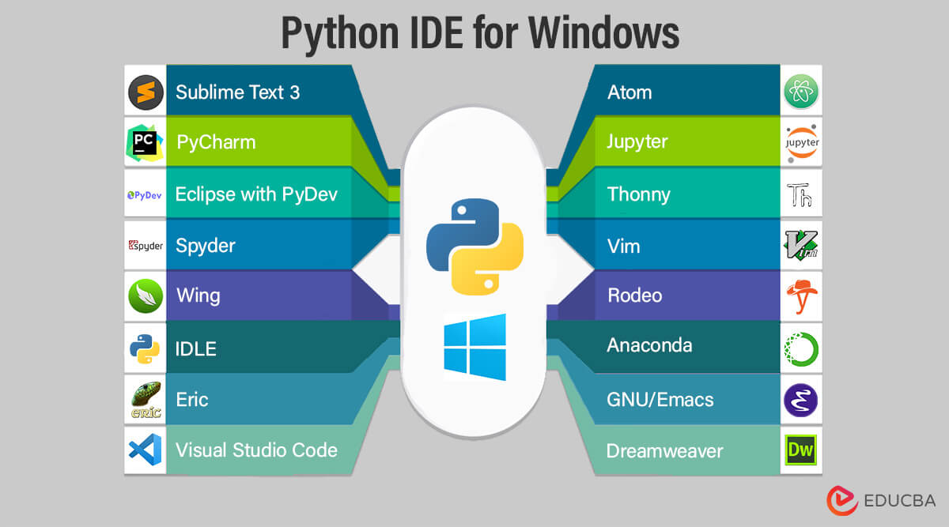

Slide 11
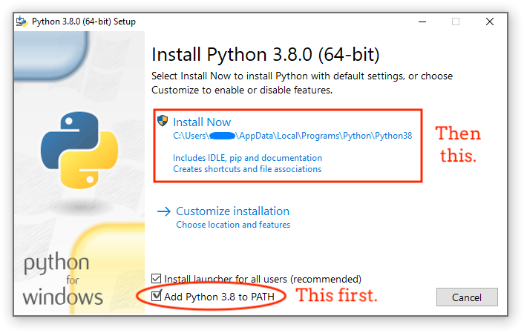
Installing Python
Go to python.org/downloads
Download the latest stable release (e.g., Python 3.12.x)
Run the installer and check:
"Add Python to PATH" (very important if you don’t want to manually set PATH later)
Then choose Customize Installation or Install Now
After installation, Python will be in a folder like: C:\Users\<YourUser>\AppData\Local\Programs\Python\Python312\
{Linux} sudo apt update - sudo apt install python3 python3-pip

Slide 12
Checking Python Installation & Version
python --version
Or
python3 --version
Checking where Python is installed
where python # Windows
which python3 # Linux/Mac
GUIDE:
https://www.dataquest.io/blog/a-complete-guide-to-python-virtual-environments/

Slide 13
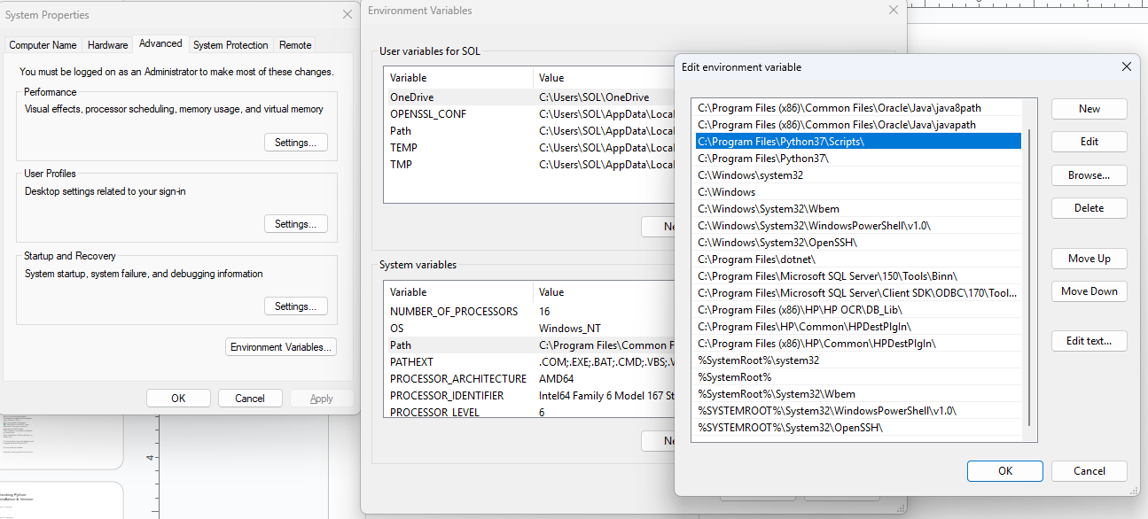
Setting the PATH Variable (Windows)
If you didn’t check “Add Python to PATH” during installation
Find your Python installation folder (e.g.,
C:\Users\<YourUser>\AppData\Local\Programs\Python\Python312\
Copy this path and the path to its Scripts folder:
C:\Users\<YourUser>\AppData\Local\Programs\Python\Python312\Scripts\
Open:
Win + R → type sysdm.cpl → Enter
Go to Advanced → Environment Variable
Under System Variables, find Path → Edit → New → paste both paths.
Close and reopen your terminal, then test: python --version

Slide 14
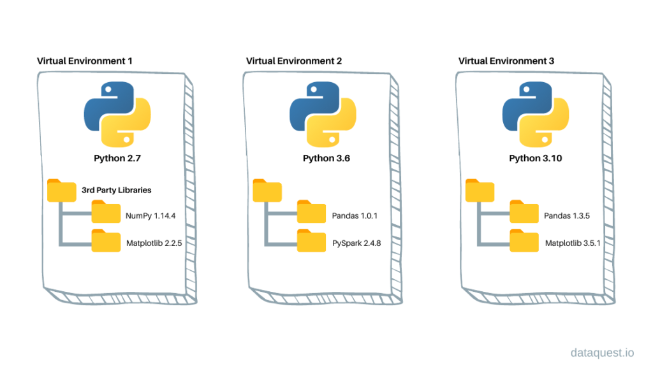
Virtual Environment Setup
Virtual environments let you create an isolated
Python workspace, so different projects can
use different package versions.
Creating a virtual environment
python -m venv myenv
Or
python3 -m venv myenv
This creates a folder myenv/ with its own Python & pip.

Slide 15
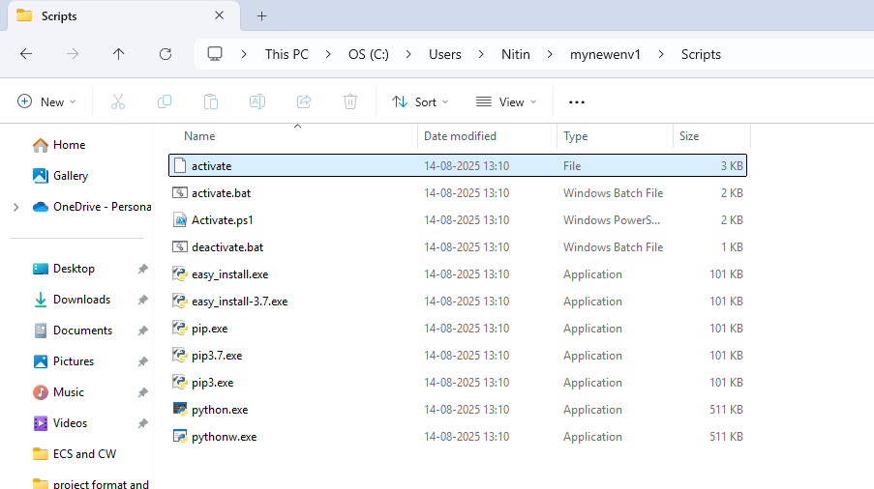
Activating/Deactivating the virtual environment:
Windows (Command Prompt):
myenv\Scripts\activate
Windows (PowerShell):
.\myenv\Scripts\Activate.ps1
Linux/Mac:
source myenv/bin/activate
OUTPUT :
When active, your prompt changes:
(myenv) C:\Users\Ravi\project>
Deactivating
deactivate

Slide 16
# Check system-wide Python installations
$ where python
C:\Users\Ravi\AppData\Local\Programs\Python\Python311\python.exe
# Check default version
$ python --version -> Python 3.12.2
# Create a virtual environment using Python 3.11
$ C:\Users\Ravi\AppData\Local\Programs\Python\Python311\python.exe -m venv py311_env
# Create a virtual environment using Python 3.12
$ C:\Users\Ravi\AppData\Local\Programs\Python\Python312\python.exe -m venv py312_env
# Activate Python 3.11 environment
$ py311_env\Scripts\activate
(py311_env) C:\Users\Ravi\project> python --version
Python 3.11.9

Slide 17
# (py311_env) C:\Users\Ravi\project> where python
C:\Users\Ravi\project\py311_env\Scripts\python.exe
C:\Users\Ravi\AppData\Local\Programs\Python\Python311\python.exe
# Deactivate it
(py311_env) C:\Users\Ravi\project> deactivate
# Activate Python 3.12 environment
$ py312_env\Scripts\activate
(py312_env) C:\Users\Ravi\project> python --version
Python 3.12.2
# (py312_env) C:\Users\Ravi\project> where python
C:\Users\Ravi\project\py312_env\Scripts\python.exe
C:\Users\Ravi\AppData\Local\Programs\Python\Python312\python.exe
# Deactivate
(py312_env) C:\Users\Ravi\project> deactivate
# Back to system default
$ python --version
Python 3.12.2

Slide 18
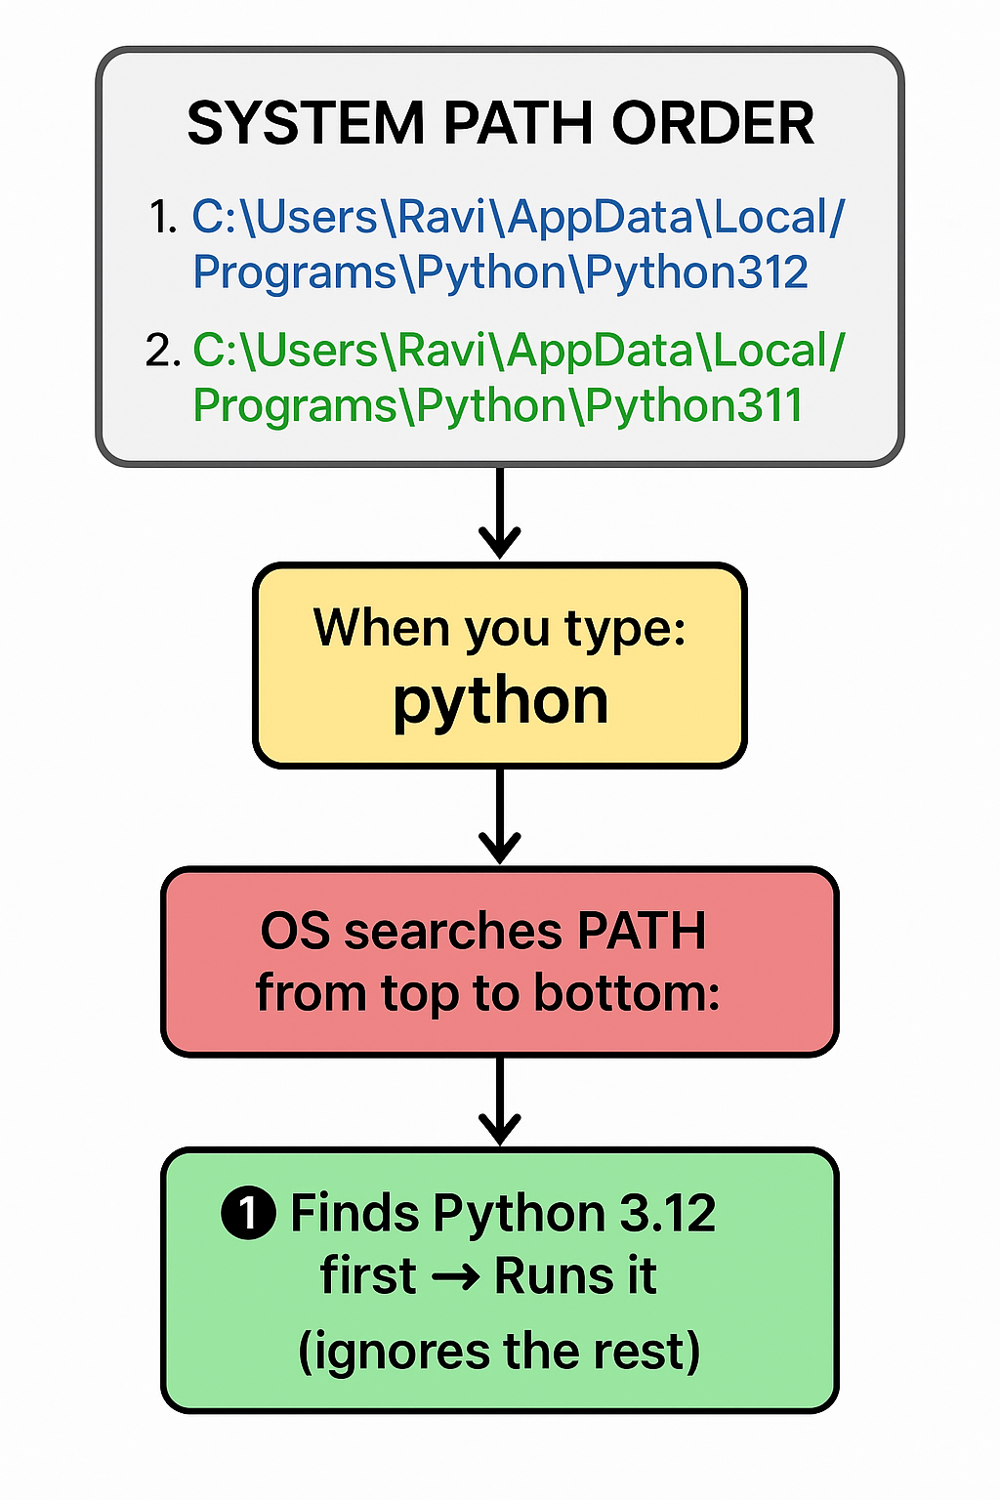
Which version will access when you fire python command by default ?

Slide 19
Hello Python & Variables
print("Hello, Python!")
# Variables
name = "Rajesh"
age = 20
marks = 85.5
is_student = True
print("Name:", name)
print("Age:", age)
print("Marks:", marks)
print("Is Student:", is_student)
name = "Alice"
age = 30
message = f"My name is {name} and I am {age} years old."
print(message)
Lab Instructions
Print your own name, age, and favorite hobby.
Create 3 variables: city, year_of_birth, height_cm and print them.
Use f-string to display: “My name is ___, I was born in ___ and my height is ___ cm.”

Slide 20
Python - Variable Names

Slide 21
Variable Names
A variable can have a short name (like x and y) or a more descriptive name (age, carname, total_volume).
Rules for Python variables:
A variable name must start with a letter or the underscore character
A variable name cannot start with a number
A variable name can only contain alpha-numeric characters and underscores (A-z, 0-9, and _ )
Variable names are case-sensitive (age, Age and AGE are three different variables)
A variable name cannot be any of the Python keywords.

Slide 22
Several Techniques
Camel Case
Each word, except the first, starts with a capital letter:
myVariableName = "raj"
Pascal Case
Each word starts with a capital letter:
MyVariableName = "raj"
Snake Case
Each word is separated by an underscore character:
my_variable_name = "raj"

Slide 23
First Program
name=”Ravi”
age=30
print(name)
print(age)
name=’rakesh’
age=20.1
print(name)
print(age)
is_adult=True
print(is_adult)
String variables can be declared either by using single or double quotes:

Slide 24
Python Indentation
Indentation refers to the spaces at the beginning of a code line.
Where in other programming languages the indentation in code is for readability only, the indentation in Python is very important.
Python uses indentation to indicate a block of code.
if 5 > 2:
print("Five is greater than two!")

Slide 25
Operators & Expressions
# Comparison
print("a > b:", a > b)
print("a == b:", a == b)
# Logical
print("a > 5 and b < 5:", a > 5 and b < 5)
# Arithmetic
a, b = 10, 3
print("Addition:", a + b)
print("Division:", a / b)
print("Floor Division:", a // b)
print("Power:", a ** b)
Lab Instructions
Write a program to calculate area of a circle (πr²).
Take two numbers as input and print which one is greater.
Check if a number is divisible by both 3 and 5.

Slide 26
If ... Else
Python supports the usual logical conditions from mathematics:
Equals: a == b
Not Equals: a != b
Less than: a < b
Less than or equal to: a <= b
Greater than: a > b
Greater than or equal to: a >= b
These conditions can be used in several ways, most commonly in "if statements" and loops.
An "if statement" is written by using the if keyword.
Let’s check == is working in python or not !
x = [1, 2, 3]
y = [1, 2, 3]
print(x == y)
# Output: True (values are the same)
print(x is y)
# Output: False (they are distinct objects in memory)
a = [1, 2, 3]
b = a
print(a is b)
# Output: True (b now refers to the same object as a)

Slide 27
Elif
elif is the keyword used for "else if"
a = 33
b = 33
if b > a:
print("b is greater than a")
elif a == b:
print("a and b are equal")

Slide 28
Else
a = 200
b = 33
c = 500
if a > b and c > a:
print("Both conditions are True")
a = 200
b = 33
if b > a:
print("b is greater than a")
elif a == b:
print("a and b are equal")
else:
print("a is greater than b")
a = 200
b = 33
c = 500
if a > b or a > c:
print("At least one of the conditions is True")

Slide 29
If condition Demo
Lab Instructions
Ask the user for 3 subject marks, calculate total and average.
Write a program to check whether a number is even or odd.
Create a simple password check program (if input matches your chosen password → "Access Granted"
marks = int(input("Enter your marks: "))
if marks >= 90:
print("Grade: A")
elif marks >= 75:
print("Grade: B")
elif marks >= 50:
print("Grade: C")
else:
print("Grade: Fail")

Slide 30
Comments
Comments start with a #, and Python will render the rest of the line as a comment:
#This is a comment.
print("Hello, World!")
Multiline comments
Python does not really have a syntax for multiline comments.
To add a multiline comment you could insert a # for each line:
""" This is a comment written in
more than just one line """

Slide 31
Assign Multiple Values
One Value to Multiple Variables
x = y = z = "Orange"
print(x)
print(y)
print(z)
x, y, z = "Orange", "Banana", "Cherry"
print(x) print(y) print(z)
Unpack a Collection
If you have a collection of values in a list, tuple etc. Python allows you to extract the values into variables. This is called unpacking.
fruits = ["apple", "banana", "cherry"]
x, y, z = fruits
print(x) print(y) print(z)

Slide 32
Input
name=input(“What is your name”)
print(name)
Exercise
Ask your superhero name and print it.

Slide 33
Check this example
Hint
x = str(3) # x will be '3'
y = int(3) # y will be 3
z = float(3) # z will be 3.0
#check the type of variable
print(type(x))
print(type(y))
first=input(“Enter first number”)
second=input(“Enter Second number”)
sum=first + second
print(sum)

Slide 34
Python Data Types
Sequence Types: list, tuple, range
Mapping Type: dict
Set Types: set, frozenset
Boolean Type: bool
Binary Types: bytes, bytearray, memoryview
None Type: NoneType
In programming, data type is an important concept.
Variables can store data of different types, and different types can do different things.
Python has the following data types built-in by default, in these categories:
Text Type: str
Numeric Types: int, float, complex

Slide 35
1. Sequence Types
a) List
Definition: Ordered, mutable (can change).
Real Life: A shopping cart in an online store (items can be added/removed).
shopping_cart = ["milk", "bread", "eggs"]
shopping_cart.append("butter")
print(shopping_cart)

Slide 36
b) Tuple
Definition: Ordered, immutable (cannot change).
Real Life: GPS coordinates or RGB color codes (once recorded, shouldn’t change).
location = (23.0225, 72.5714) # Ahmedabad GPS coordinates
color = (255, 0, 0) # Red in RGB

Slide 37
c) Range
Definition: Sequence of numbers (immutable).
Real Life: Roll numbers in a class, or seat numbers in a cinema hall.
roll_numbers = range(1, 51) # 50 students
for r in roll_numbers:
print(r, end=" ")
for i in range(2,6):
print(i)

Slide 38
2. Mapping Type
Dictionary (dict)
Definition: Key-value pairs.
Real Life: Phone directory (name → phone number), student database (roll → marks).
phonebook = {"Alice": "9876543210", "Bob": "9123456789"}
print("Bob's number:", phonebook["Bob"])

Slide 39
3. Set Types
a) Set
Definition: Unordered, unique items, mutable.
Real Life: Unique visitors on a website (no duplicates).
visitors = {"Alice", "Bob", "Alice"}
print(visitors) # duplicates removed → {"Alice", "Bob"}

Slide 40
b) Frozenset
Definition: Unordered, unique items, immutable.
Real Life: Bank account numbers assigned to a customer — unique & fixed.
account_numbers = frozenset([12345, 67890, 12345])
print(account_numbers)

Slide 41
Boolean Type (bool)
Definition: True or False.
Real Life: Login authentication (password correct → True, else False).
password = "admin123"
print(password == "admin123") # True

Slide 42
5. Binary Types
a) Bytes
Definition: Immutable sequence of bytes.
Real Life: Storing images, audio, or encrypted files in memory.
data = b"Cybersecurity"
print(data[0]) # 67 → ASCII of 'C'

Slide 43
b) Bytearray
Definition: Mutable sequence of bytes.
Real Life: Editing an image or file in memory.
file_data = bytearray(b"HELLO")
file_data[0] = 104 # Change 'H' to 'h'
print(file_data) # b'hello'

Slide 44
c) Memoryview
Definition: Access slices of data without copying.
Real Life: Working with large video/audio files without loading whole file in memory.
data = bytearray(b"PYTHON")
view = memoryview(data)
print(view[0]) # 80 (ASCII for 'P')

Slide 45
6. None Type (NoneType)
Definition: Represents absence of value.
Real Life: Flight seat not booked yet, or search result not found.
seat = None
if seat is None:
print("Seat is not reserved yet.")

Slide 46
Data Type
x = str("Hello World")
x = int(20)
x = float(20.5)
x = complex(1j)
x = list(["one", "two", "three"])
x = tuple(("apple", "banana", "cherry"))
x = range(6)
x = dict(name="John": age=36)
x = set(("apple", "banana", "cherry"))
x = frozenset(("apple", "banana", "cherry"))
x = bool(5)
x = bytes(5)
x = bytearray(5)
x = memoryview(bytes(5))

Slide 47
Python - Global Variables

Slide 48
Global variables can be used by everyone, both inside of functions and outside.
x = "Have Great Week Ahead!"
def myfunc():
print("To All of you " + x)
myfunc()

Slide 49
Check this now !
x = "awesome"
def myfunc():
x = "fantastic"
print("Python is " + x)
myfunc()
print("Python is " + x)
def myfunc():
global x
x = "fantastic"
myfunc()
print("Python is " + x)

Slide 50
What is Unicode System?
Software applications often require to display messages output in a variety in different languages such as in English, French, Japanese, Hebrew, or Hindi. Python's string type uses the Unicode Standard for representing characters.
It makes the program possible to work with all these different possible characters.
A character is the smallest possible component of a text. 'A', 'B', 'C', etc., are all different characters. So are 'È' and 'Í'.
A unicode string is a sequence of code points, which are numbers from 0 through 0x10FFFF (1,114,111 decimal).
This sequence of code points needs to be represented in memory as a set of code units, and code units are then mapped to 8-bit bytes.

Slide 51
Unicode
s = '\xe0\xa4\xb9\xe0\xa5\x80 \xe0\xa4\xac\xe0\xa5\x8b\xe0\xa4\xb2'
s.encode('raw-unicode-escape').decode('utf-8')
'ही बोल'
string = "\u20B9"
print (string)

Slide 52
Loops in Python

Slide 53
Python While Loops
Python has two primitive loop commands:
while loops
for loops

Slide 54
While loop
For loop
i = 1
while i < 10:
print(i)
i += 1
items= ["Good", "bad”, "ugly"]
for x in items:
print(x)

Slide 55
MIX loop with break
MIX loop with continue
i = 1
while i < 10:
print(i)
if i == 3:
break
i += 1
i = 0
while i < 10:
i += 1
if i == 3:
continue
print(i)

Slide 56
Loops
# For loop - Multiplication Table
num = 5
for i in range(1, 11):
print(num, "x", i, "=", num * i)
# While loop - Sum of numbers
n = 1
total = 0
while n <= 10:
total += n
n += 1
print("Sum of 1 to 10:", total)

Slide 57
Lab Instructions
Print multiplication table of any number (user input).
Find sum of numbers from 1 to 100.
Reverse a number (e.g., 123 → 321) using a while loop.

Slide 58
For loop example with iterator
print("List Iteration")
l = ["nfs", "for", "training"]
for i in l:
print(i)
print("\nTuple Iteration")
t = ("three", "four", "one")
for i in t:
print(i)
print("\nString Iteration")
s = "Raviraj"
for i in s:
print(i)
print("\nDictionary Iteration")
d = dict({'x':123, 'y':354})
for i in d:
print("%s %d" % (i, d[i]))

Slide 59
print("\nSet Iteration")
set1 = {1, 2, 3, 4, 5, 6}
for i in set1:
print(i)

